Slide 1
Signals & Systems
Predicting System Performance
February 27, 2013

Slide 2
Outline
System functions: primitives and compositions
Modes of feedback systems
Finding and interpreting poles
Reading: Chapter 5.5 – 5.7 of Digital World Notes

Slide 3
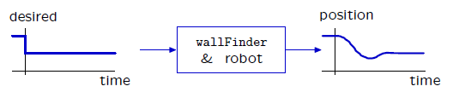
Performance analysis
We can quantify the performance of a system by characterizing the signals that the system generates.

Slide 4

Analyzing systems
Our goal is to develop representations for systems that facilitate analysis.
Examples:
Does the output signal overshoot? If so, how much?
How long does it take for the output signal to reach its final value?

Slide 5

System functions
Any LTI system is completely characterized by the relationship between the input signal X and the output signal Y .
We call this relationship,
the system function. It is independent of any particular input signal, just as a mathematical function or a Python procedure is an entity, independent of its arguments.
System functions for LTI systems are always
ratios of polynomials in R.

Slide 6
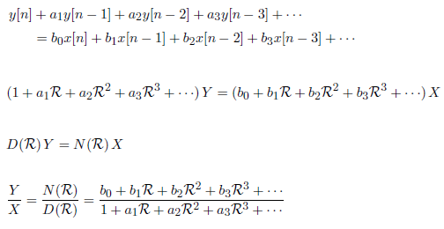
System functions for LTI systems
Ratio of polynomials in R:
Persistent part of response of such a system is associated with de- nominator.

Slide 7
System functions: Why do we care
PCAP system on system functions makes it easier to combine models than manipulating systems of operator equations.
System functions expose important analytic properties of the system.

Slide 8
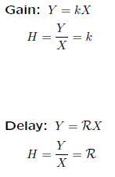
PCAP: Primitive SFs

Slide 9
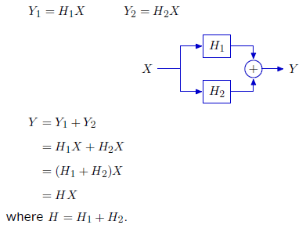
Combining SFs: Sum
The system function of the sum of two systems is the sum of their system functions.

Slide 10
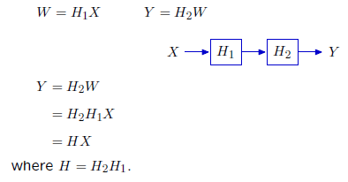
Combining SFs: Cascade
The system function of the cascade of two systems is the product of their system functions.

Slide 11
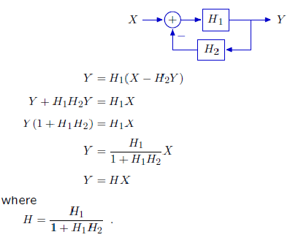
Combining SFs: Negative feedback
Concentrate on negative feedback and Black's formula:

Slide 12
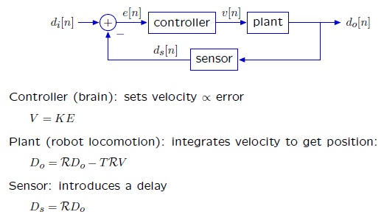
Wall finder
Control the robot to move to desired distance from a wall.

Slide 13
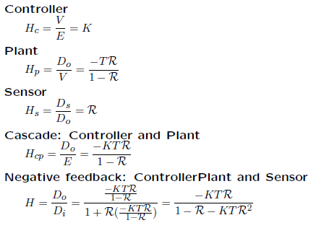
Use composition to find SF

Slide 14
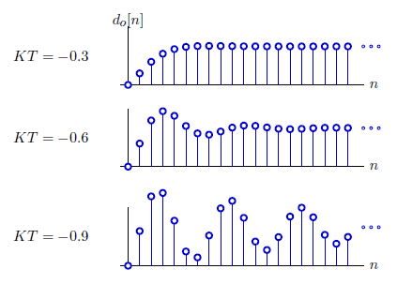
Wall finder
The behavior of the system depends critically on KT.

Slide 15
Predicting properties of system behavior
Consider how the system behaves given input signals with different properties:
• Unit sample (this lecture)
• Transient : finitely many non-zero samples
• Bounded : exist values u, l such that l < x[n] < u for all n
Understanding unit-sample response is the basis for understanding
response to more complex signals.
We can predict system behavior (slowly) by simulating any system.
We can quickly predict long-term behavior of the unit-sample response based on the denominator of the system function.

Slide 16

Feed-forward systems
Output has no dependence on previous outputs
Unit-sample response is finite sum of scaled, delayed unit-samples
Unit-sample response is transient: finitely many non-zero values

Slide 17
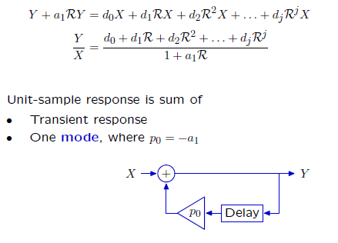
Feedback systems: First-order case

Slide 18
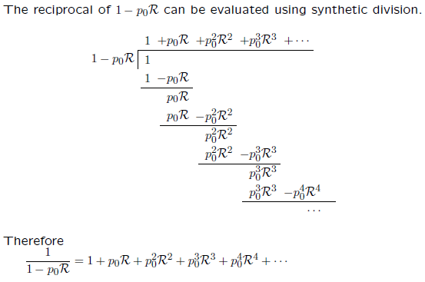
Feedback

Slide 19
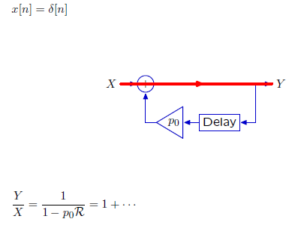
Feedback: Cyclic signal flow paths
Feedback implies cyclic signal flow paths.

Slide 20
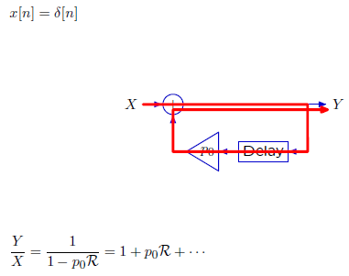
Feedback: Cyclic signal flow paths
Feedback implies cyclic signal flow paths.

Slide 21
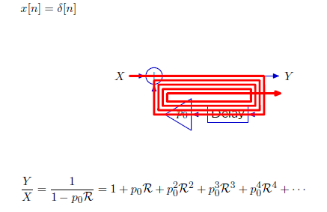
Feedback: Cyclic signal flow paths
Feedback implies cyclic signal flow paths.
All cyclic paths must contain at least one delay.

Slide 22
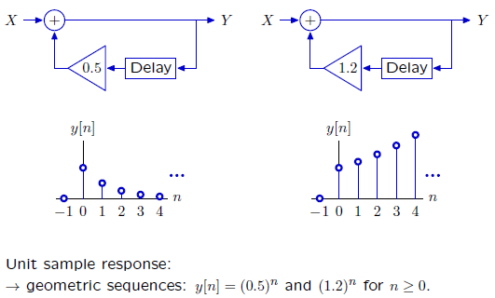
Unit sample response: Geometric growth
If traversing the cycle decreases or increases the magnitude of the signal, then the output will decay or grow, respectively.

Slide 23
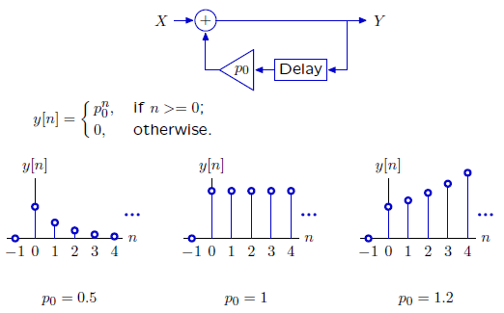
Unit sample response: Geometric growth
These system responses can be characterized by a single number (the pole), which is the base of the geometric sequence.

Slide 24
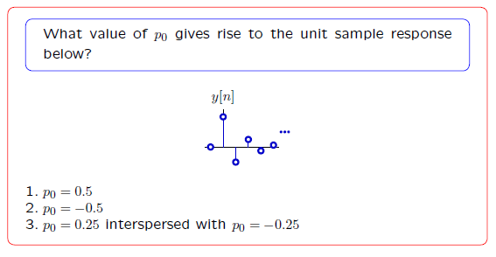
Cohort Question 1

Slide 25
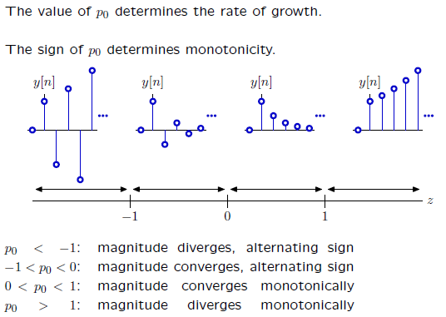
Geometric growth

Slide 26
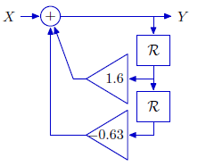
Second-order systems
The unit-sample response of more complicated cyclic systems is more complicated.

Slide 27
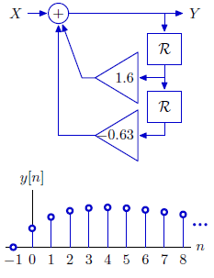
Second-order systems
The unit-sample response of more complicated cyclic systems is more complicated.
Not geometric. This response grows then decays.

Slide 28
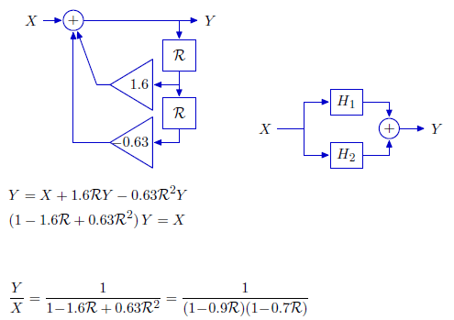
Second-order systems: Additive decomposition
This system function can be written as a sum of simpler parts.

Slide 29
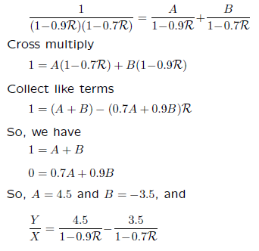
Additive decomposition: partial fraction expansion

Slide 30
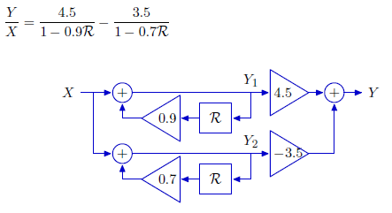
Second-order systems: Additive decomposition

Slide 31
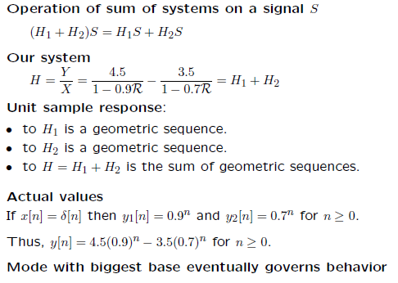
Second-order systems: Additive decomposition

Slide 32
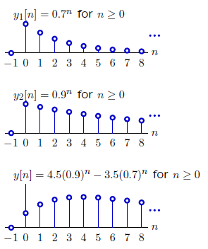
Sum of geometric sequences
Mode with biggest base eventually governs behavior

Slide 33
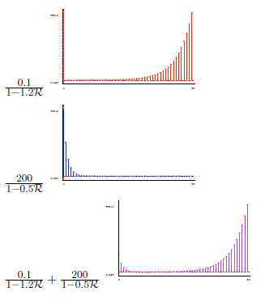
More dramatically

Slide 34
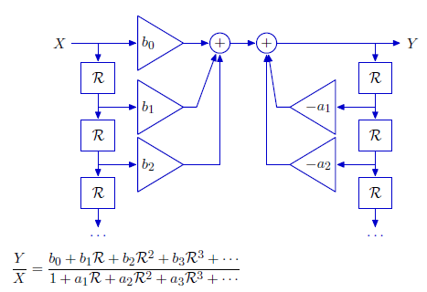
Analysis of more complicated systems
Rational polynomials can be realized with block diagrams of the following form:

Slide 35
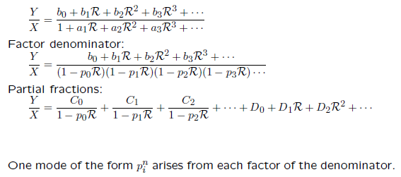
Analysis of more complicated systems
Modes can be identified by expanding system functional in partial fractions.

Slide 36
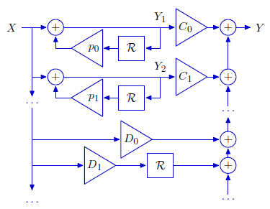
Analysis of more complicated systems
Modal decomposition provides an alternative block diagram.
The upper part is cyclic; the lower part is acyclic.

Slide 37
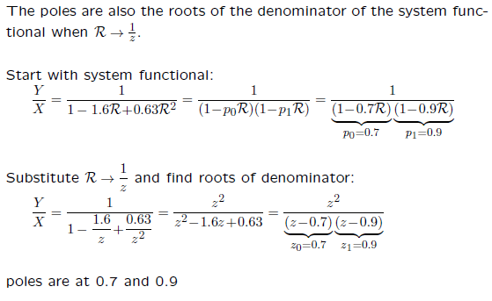
Easy way to find poles

Slide 38
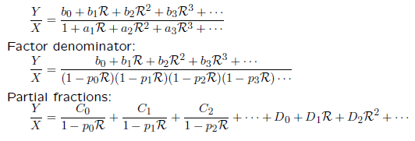
Complex Roots
What if a root has a non-zero imaginary part?
Factor theorem: express a polynomial as a product of factors, with one factor associated with each root of the polynomial.
Fundamental theorem of algebra: a polynomial of order n has n roots. The roots can have imaginary parts.
How does a mode from a complex root behave?

Slide 39
Complex Poles
Difference equations that represent physical systems (e.g., population growth, bank accounts, etc.) have real-valued coefficients.
Difference equations with real-valued coefficients generate real-valued outputs from real-valued inputs.
But they might still have complex poles.

Slide 40
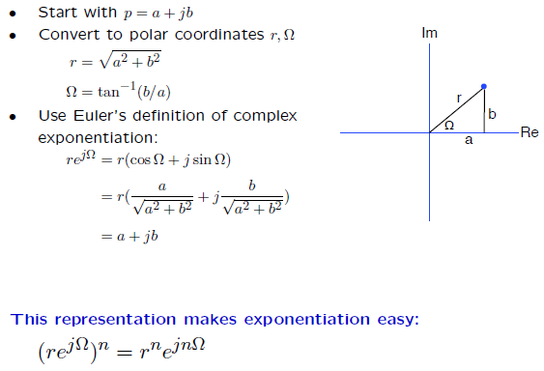
Representing complex numbers

Slide 41
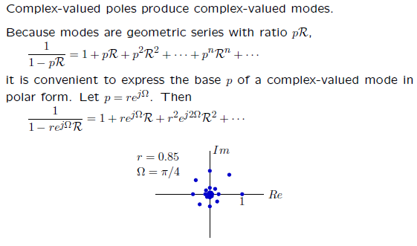
Complex Poles

Slide 42
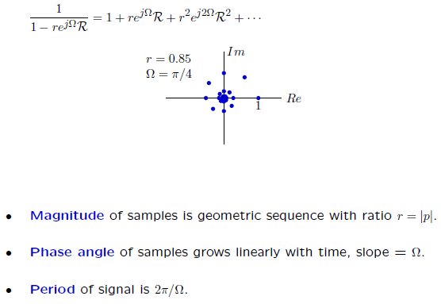
Complex Poles

Slide 43
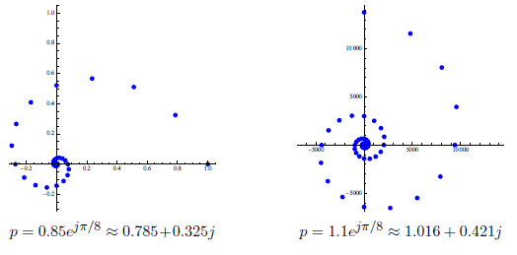
Convergence and Divergence

Slide 44
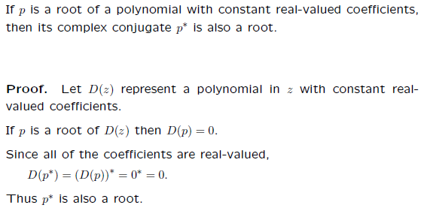
Complex Roots
Self Reading: Complex Conjugate Root Theorem:
http://en.wikipedia.org/wiki/Complex_conjugate_root_theorem

Slide 45
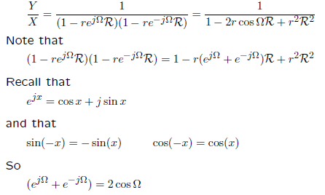
Complex Roots
If we pair the factors corresponding to complex-conjugate roots, the resulting polynomial has real-valued coefficients.

Slide 46
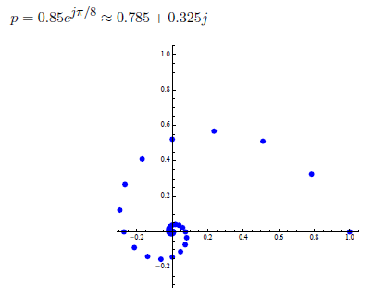
Complex modes, Real results

Slide 47
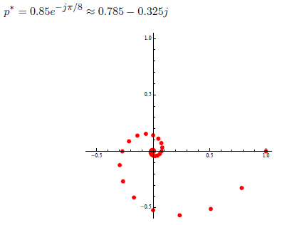
Complex modes, Real results

Slide 48
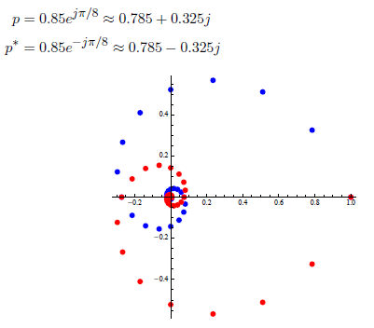
Complex modes, Real results

Slide 49
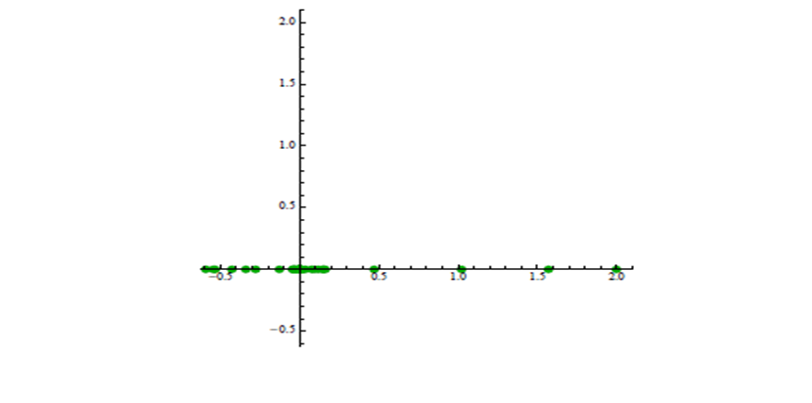
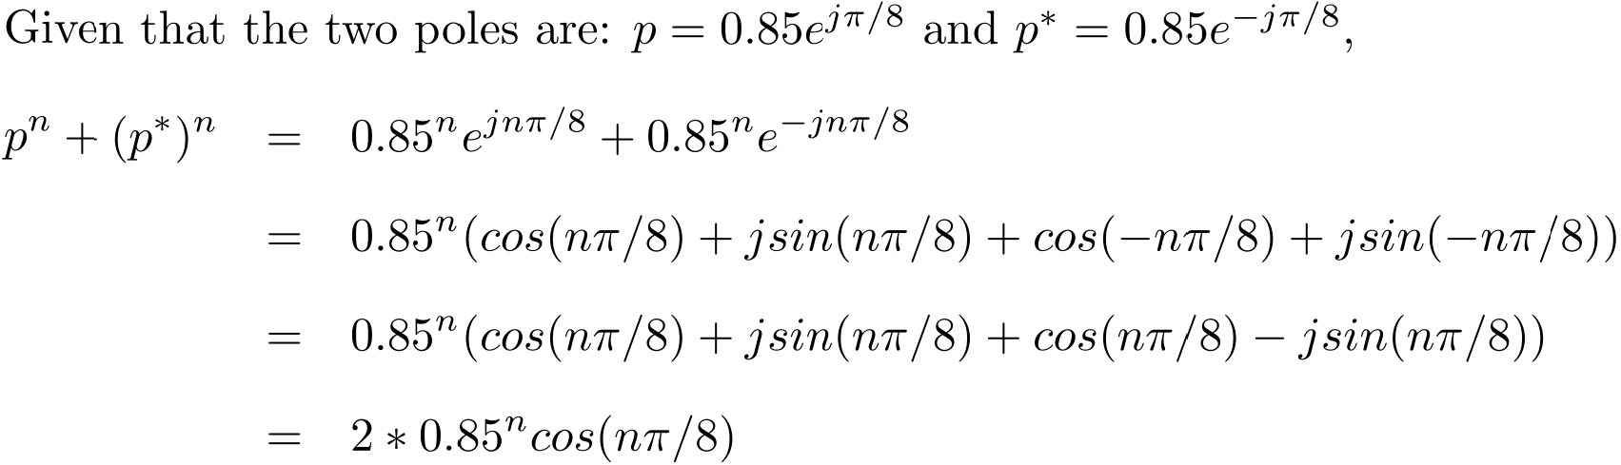
Complex modes, Real results

Slide 50
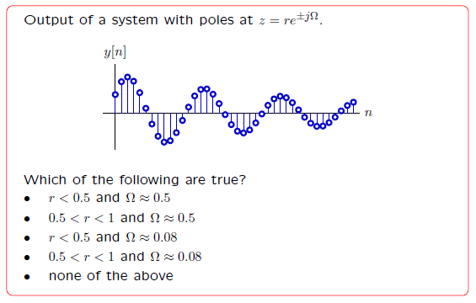
Cohort Question 2

Slide 51
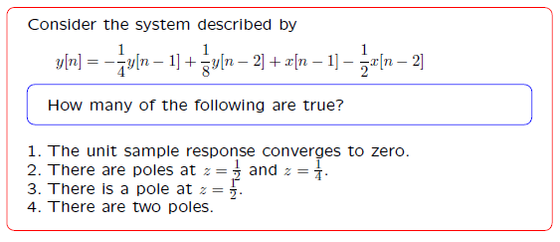
Cohort Question 3

Slide 52
Poles and convergence
The dominant pole is the pole with the largest magnitude.
If the dominant pole has magnitude > 1, then in response to a bounded input, the output signal will be unbounded.
If the dominant pole has magnitude < 1, then in response to a bounded input, the output signal will be bounded; in response to a transient input, the output signal will converge to 0.
If the dominant pole has magnitude 1, then in response to a bounded input, the output signal will be bounded; in response to a transient input, it will converge to some constant value.

Slide 53
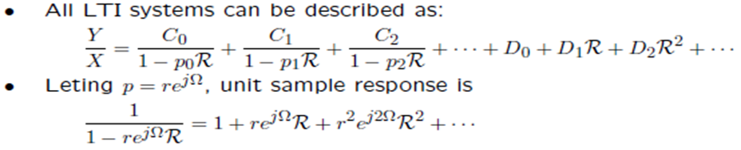
Poles and periodicity
The dominant pole is the pole p = a + bj with the largest magnitude.
Assume that |p| is not 1 or 0 and Y = Hδ, there exists a time t such that:
If b = 0, a > 0, y[n] is monotonically decreasing or increasing.
If b = 0, a < 0, y[n] is alternating signs.
Otherwise, oscillating

Slide 54
This Week
Readings: Chapter 5.5-5.7 of Digital World Notes (mandatory!)
Cohort Exercises & Homework: Practice on LTI systems (note the due dates & times)
Lab: Analyzing robot control system for stability

